Slide 1

Intramural Scheduling Optimization UMass RecWell
9-26-2025

Slide 2
Quick Agenda
What’s our problem?
Introduction to Optimization
My Solution
Quick Demo
Feedback & Future

Slide 3

Our Problem
Each PA (Program Assistant) schedules ~15-40 Officials for ~40-60 games each week
- Must balance game difficulty, Officials experience & effort, balancing hours, etc.
→ Requires looking at master schedule, fusion play, official evals., etc. all simultaneously
Schedules are reused week-to-week to decrease office time but at the cost of game variety
Scheduling time inhibits other work (contacting teams, other intramural events)
First week schedules take 2+ hours when familiarizing with referees and divisions
Successive weeks still take 1+ hours to adjust based week-to-week changes

Slide 4
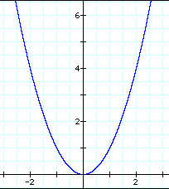
Quick Sidebar: What is Optimization?
Optimization
Three sentence Summary
- Optimization is defined as:
‘the action of making the best or most effective use of a situation or resource.’
In Mathematics / Operations Research:
‘Maximizing or Minizing a real valued function by systematically choosing inputs and computing the value of the function’
For example, lets take the simple function f(x)=x^2
Minimizing this function means picking the best x such that f(x) is the lowest value
As in the figure, just pick the lowest point
X=0: ‘Optimal Value’

Slide 5
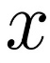

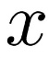
Quick Sidebar: How does this relate
Optimization
In Operations Research, The process to model and optimize is
< 5
max/min
over possible
display best
01
02
03
04
Define Constraints
DEFINE
objective
SOLVe FOR OPTIMAL SCHEDULE
TRANSLATE TO BUISNESS DECISION
What must no happen, regardless of schedule
- Ex: Officials must have availability for the time they’re working
Real-Valued function that represents Goals of the scheduling:
- Ex: Rewarding a balancing of hours between officials
Give to a Solver that finds the best input to your objective
- Just like finding x=0 on the last slide
Translate to meaningful values that solve the problem
- Ex. Output a schedule for referees that covers the whole week

Slide 6
My Solution
Constraints and Objective:
Define Constraints based on hardset rules
Must have 2-3 officials per game, scheduling for availability, keeping under 20 hours, etc.
Define Objective on accepted goals
Weighted combination of: Hours Balancing, Officials Effort, Officials Experience, Game Difficulty, and rewarding Large Time Blocks
Allow for custom weighting of objective based on PA’s needs
Translate to business practices:
Create an simple & accessible that works based on pre-existing excel format and preserves information security (does not store information)
Scales for all leagues and any future activities

Slide 7
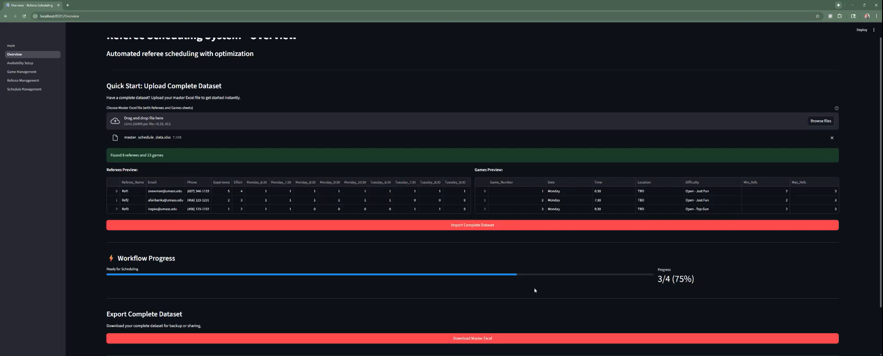
Demo Video / Real Demo

Slide 8

Feedback & Future
Future:
I plan to add game location and excel input considerations, fusion play copy-paste integration, and to decrease scheduling time with problem compression techniques
The goal would be to deploy this on a RecWell system on the intramural computers for easy accessibility for all future PAs.
Feedback:
I plan to continue to develop this in junction with feedback from PAs and Pro Staff, hopefully continuing to assess more needs as the year progresses.

